Slide 1


Slide 2





Visión general del sistema
Servidor
Cliente
Restaurant
Repartidor
Payment Gateway

Slide 3
Comunicación y Concurrencia

Slide 4
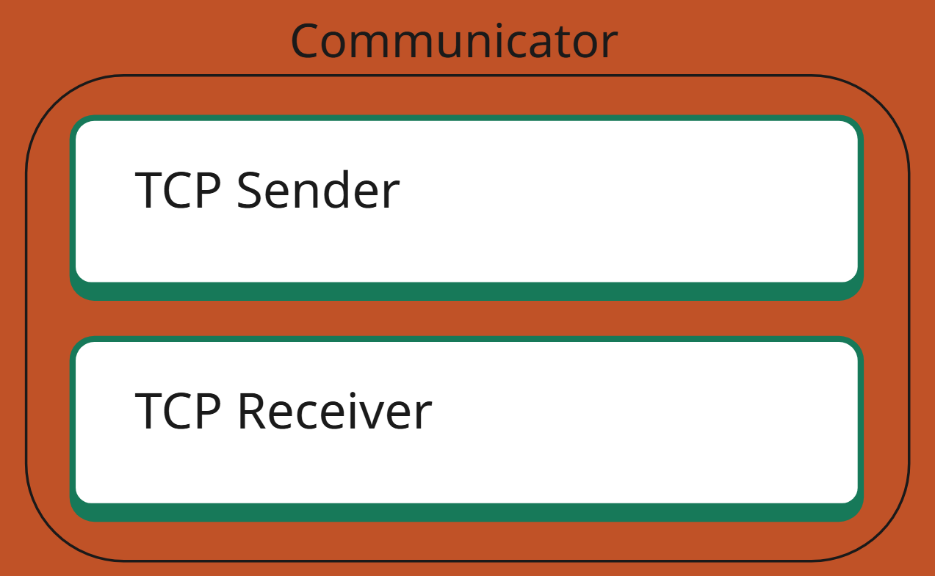
TCP Sender / TCP Receiver
Actor Sender
Actor Usuario
Actor Servidor
Actor Receiver

Slide 5
Modelo de Actores y Servicios Internos

Slide 6
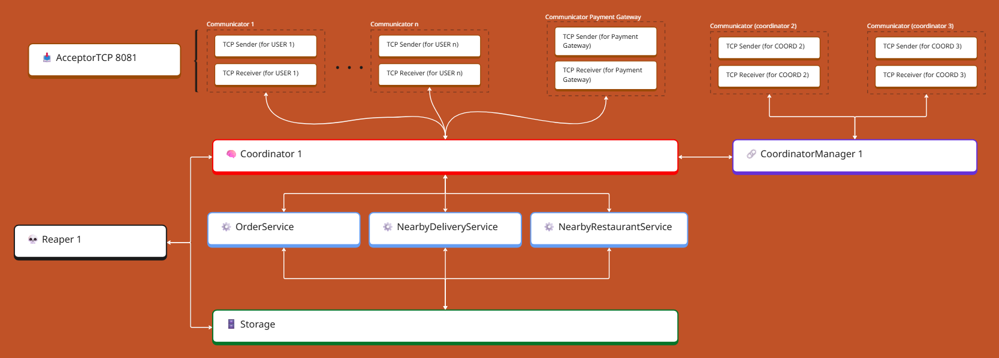

Slide 7
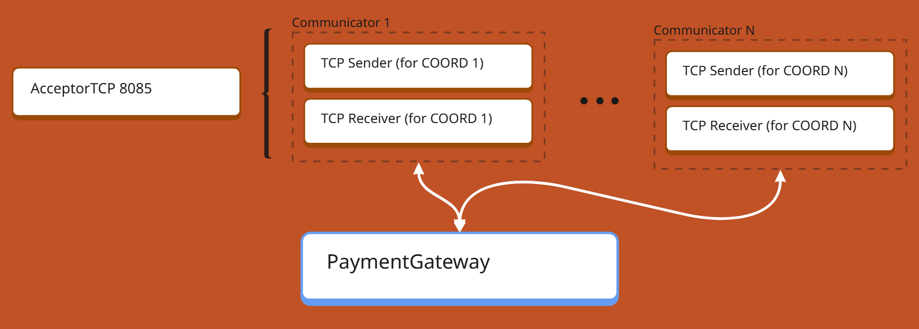

Slide 8
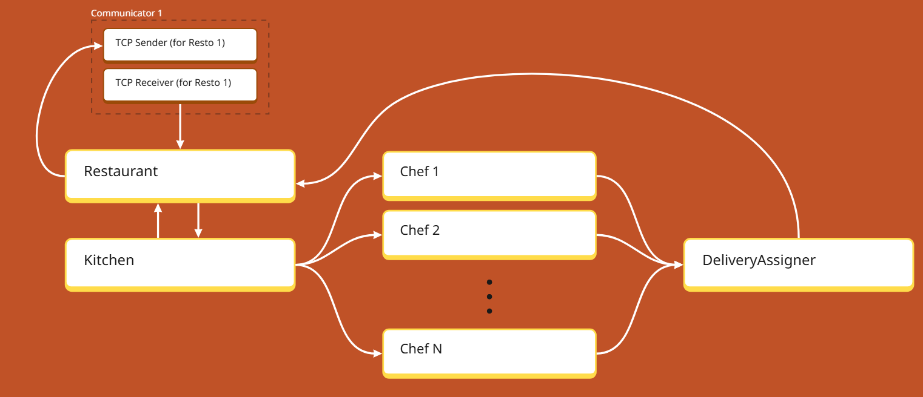

Slide 9
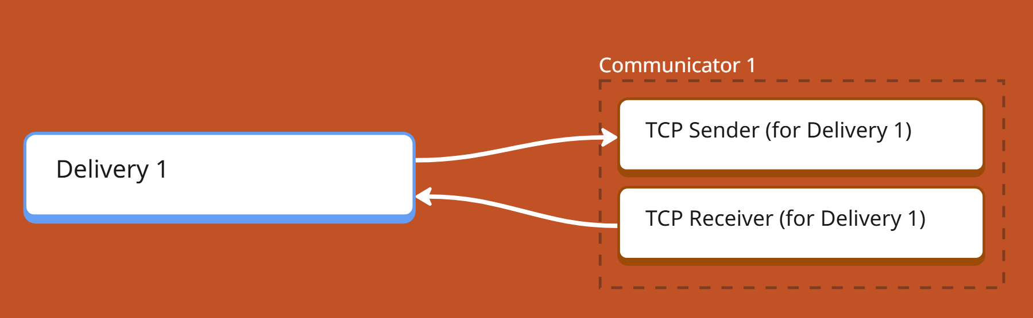

Slide 10
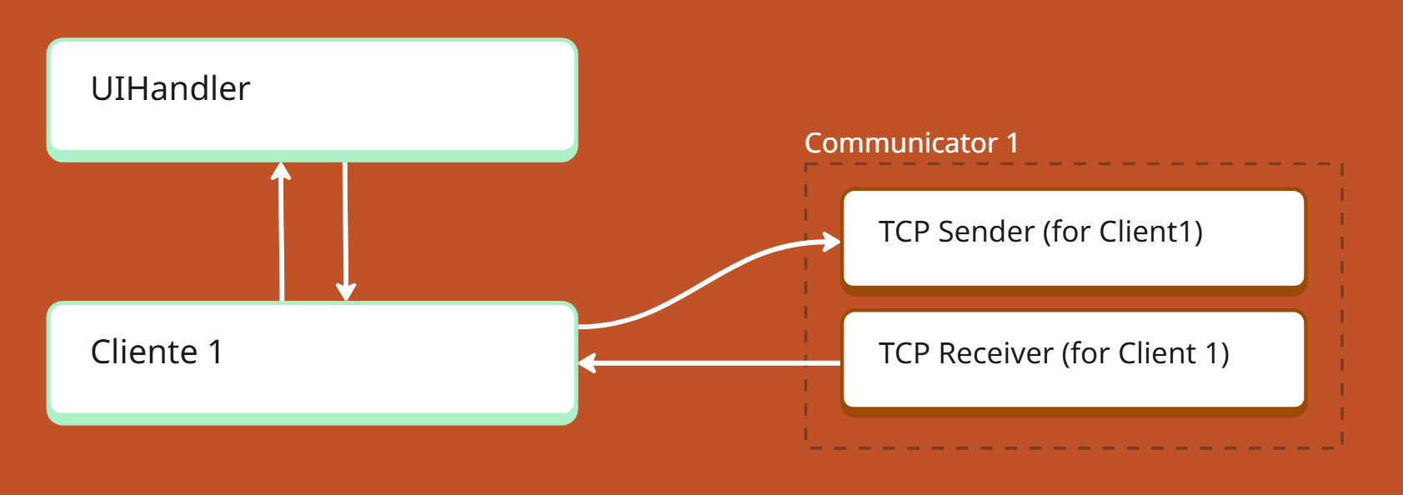

Slide 11
Tolerancia ante fallos

Slide 12


Heartbeats periódicos → Algoritmo de Elección

Slide 13
Algoritmo de elección en anillo
Servidor 1
Servidor 2
Servidor 4
Servidor 3

Slide 14
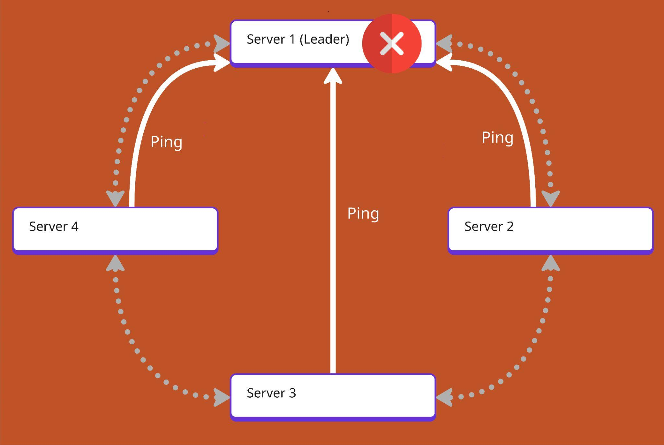
Caso 1: Caída del líder

Slide 15
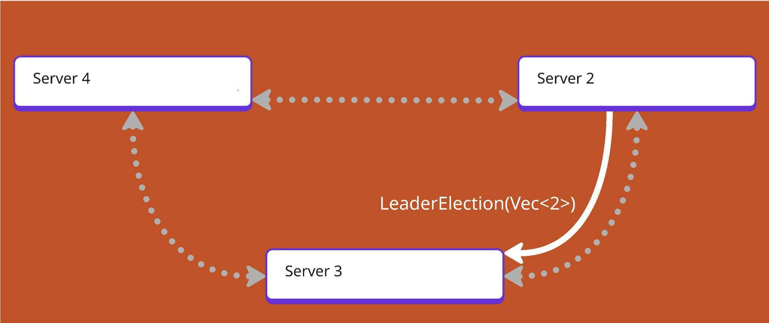

Slide 16
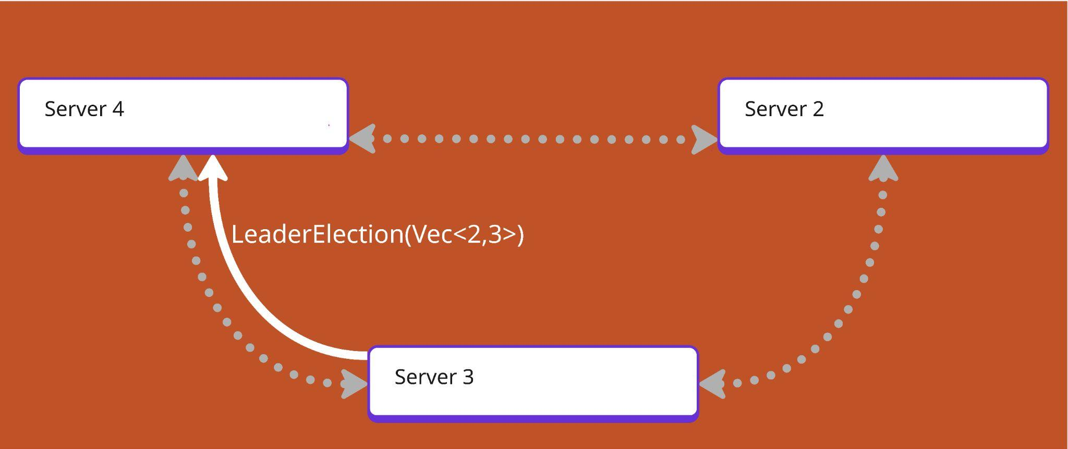

Slide 17
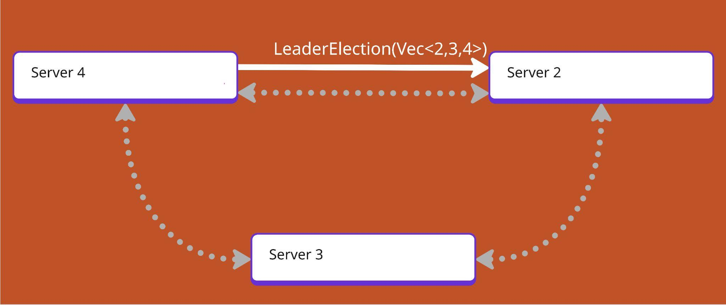

Slide 18
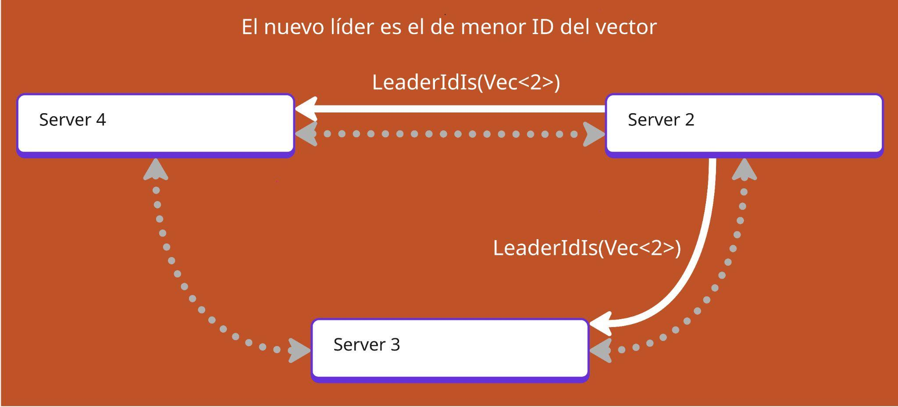

Slide 19
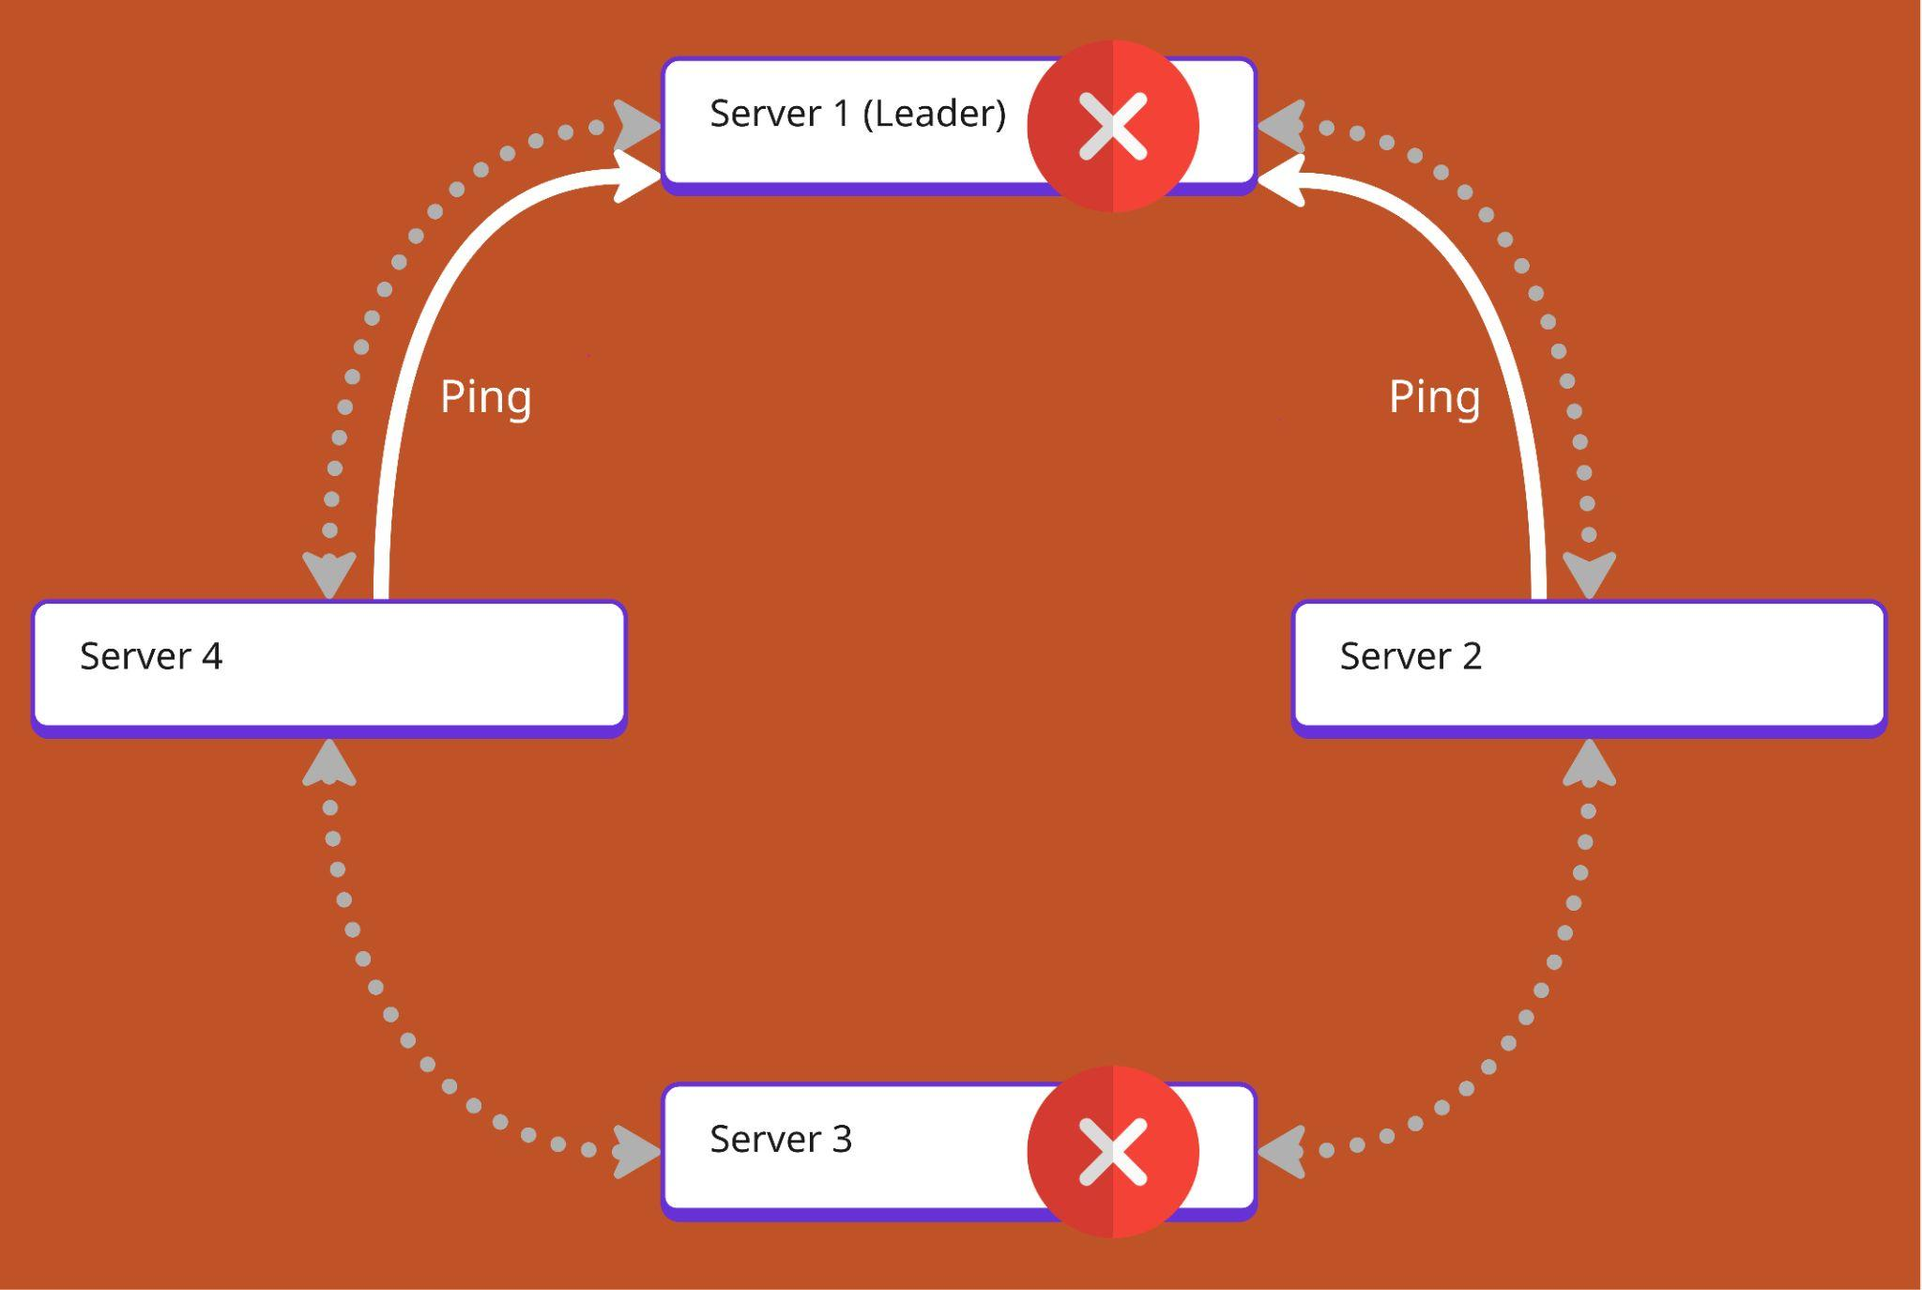
Caso 2: Caída del líder y otro servidor intermedio

Slide 20
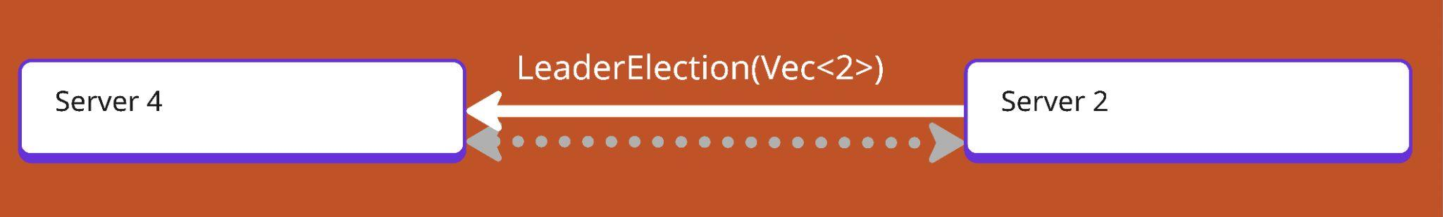

Slide 21
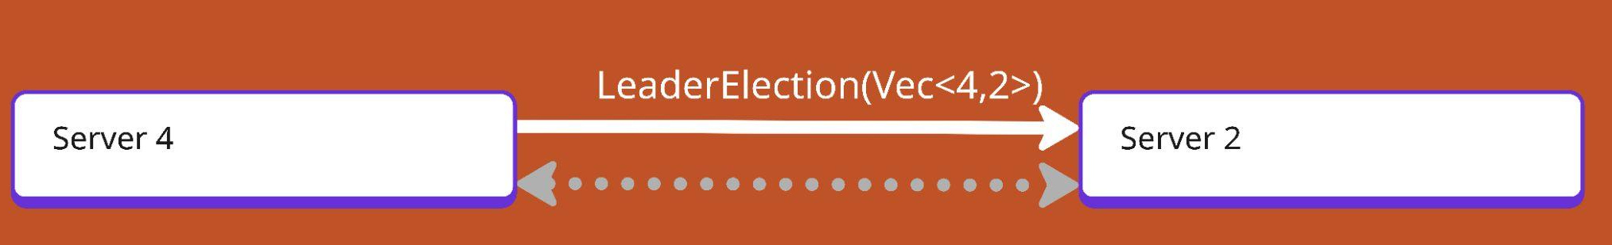

Slide 22
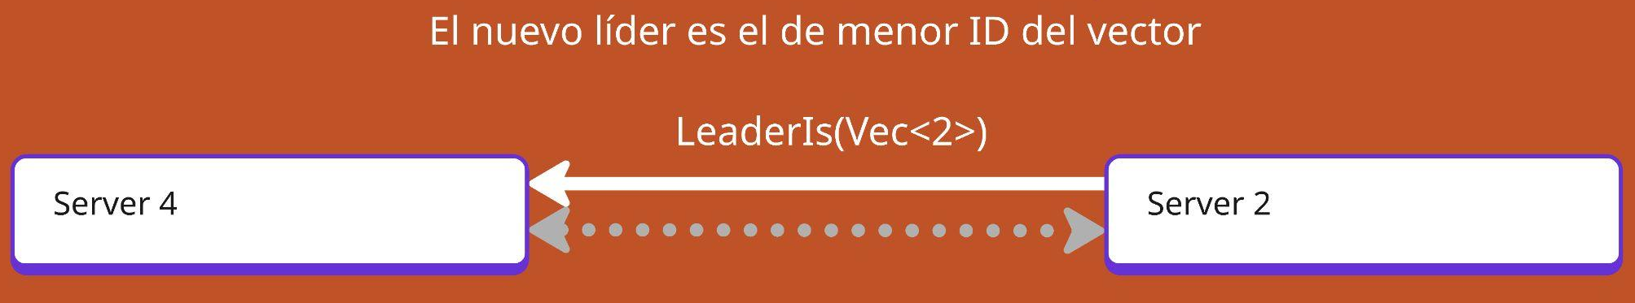

Slide 23
Resiliencia de datos

Slide 24
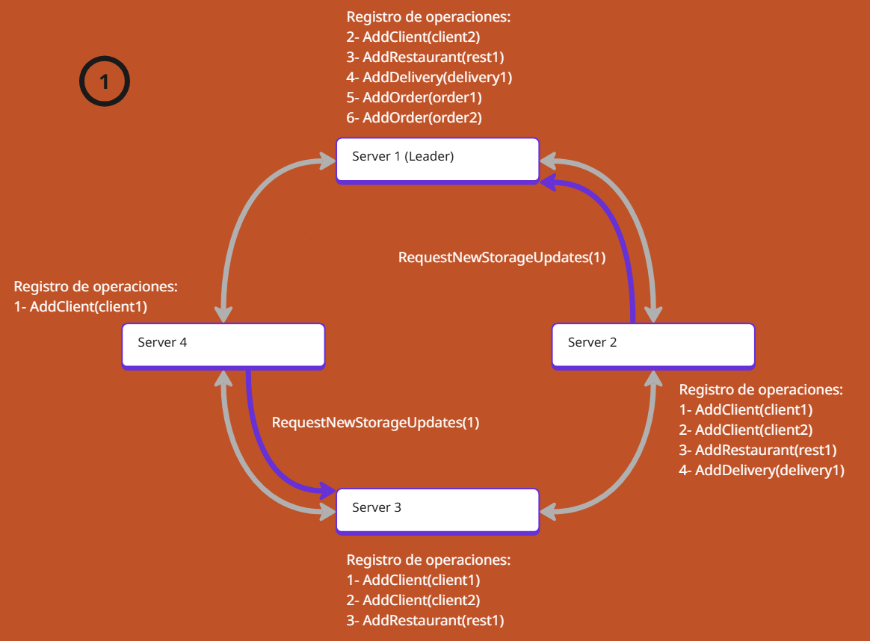

Slide 25
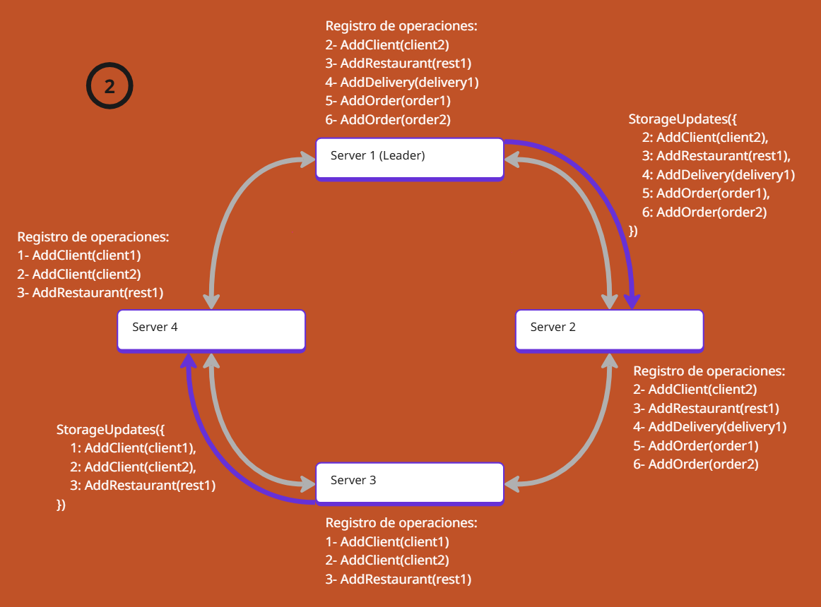

Slide 26
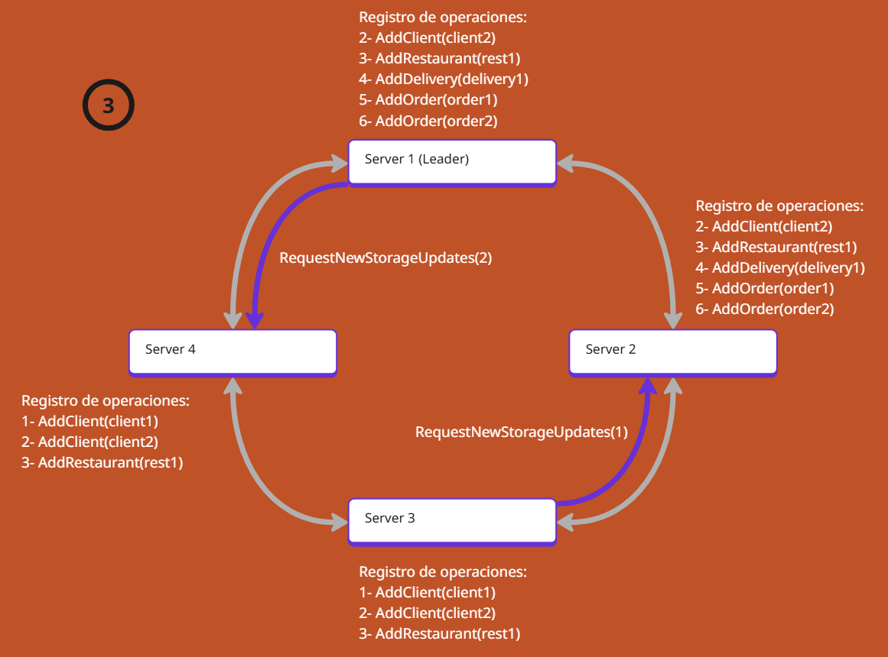

Slide 27
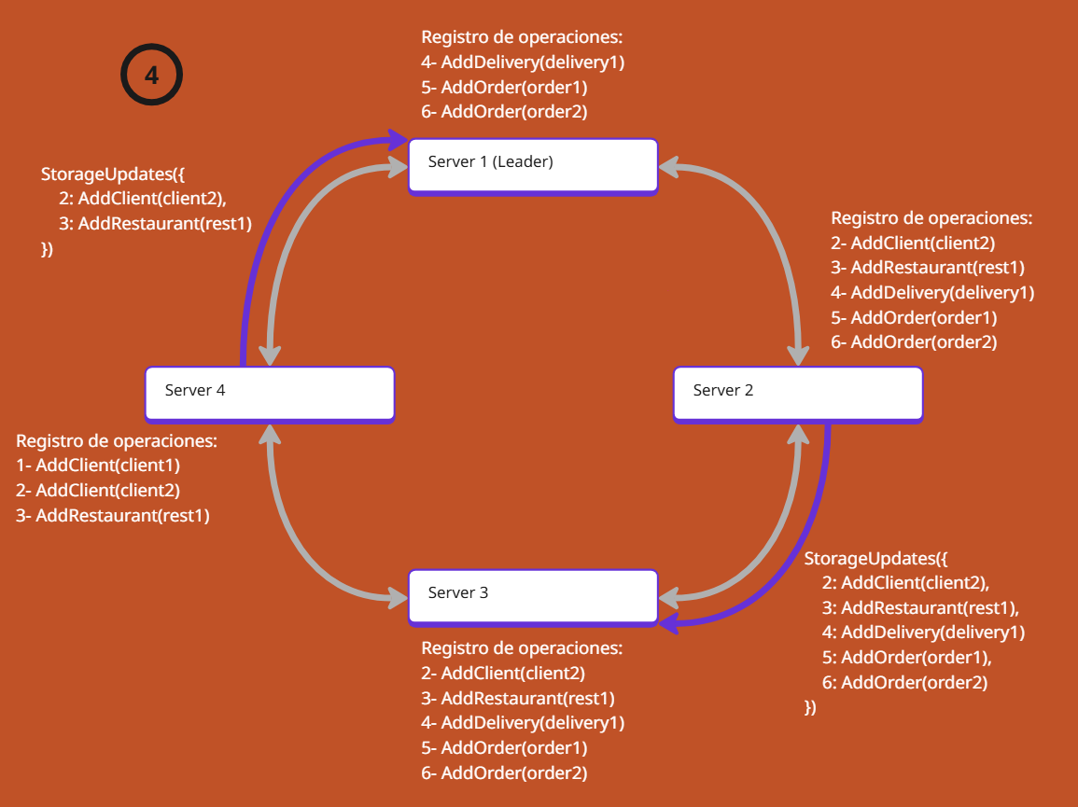

Slide 28
Conexión de un usuario al sistema

Slide 29
Mensajes Internos
Mensajes
por red

Slide 30

Payment Gateway
WhoIsLeader?

Slide 31
LeaderIs(X)
Payment Gateway

Slide 32
WhoIsLeader?
Payment Gateway

Slide 33
LeaderIs(X)
Payment Gateway

Slide 34
RegisterUser(info)
Payment Gateway

Slide 35
RecoveredInfo
NoRecoveredInfo
Payment Gateway

Slide 36
Flujo de un pedido

Slide 37
RequestNearbyRestaurants
Payment Gateway

Slide 38




RequestNearbyRestaurants
GetAllRestaurants

Slide 39
NearbyRestaurants
RestaurantDTOs

Slide 40
NearbyRestaurants
Payment Gateway

Slide 41
SendThisOrder(OrderDTO)
Payment Gateway

Slide 42
NewOrder
RequestAuthorization

Slide 43
NotifyOrderUpdated
AuthorizationResult
NewOrder
AddOrder

Slide 44
NotifyOrderUpdated
NewOrder
Payment Gateway

Slide 45



RequestNearbyDelivery
NewOrder
RequestNearbyDelivery
SendToKitchen
AssignToChef
SendThisOrder

Slide 46
RequestNearbyDelivery

Slide 47
RequestNearbyDeliverys
GetAllAvailableDeliveries

Slide 48
NearbyDeliverys
DeliveryDTOs

Slide 49
NewOfferToDeliver
NewOfferToDeliver
NewOfferToDeliver

Slide 50
(2)
AcceptedOrder
AcceptOrder
AddOrderAccepted
(1)
AcceptOrder

Slide 51
DeliveryAvailable
DeliveryAvailable
(2)
DeliveryNoNeeded
DeliveryNoNeeded
DeliveryNoNeeded
DeliveryAvailable
(1)
Waiting confirmation…

Slide 52
DeliverThisOrder
DeliveryAvailable
DeliverThisOrder
DeliveryAvailable

Slide 53
DeliverThisOrder
DeliverThisOrder
(2)
Available
FinishDeliveryAssignment
(1)
Waiting
Confirmation…

Slide 54
DeliverThisOrder
(2)
Available
(1)
DeliverThisOrder
Delivering…

Slide 55
OrderDelivered
BillPayment
UpdateOrderStatus
(1)
OrderDelivered

Slide 56
NotifyOrderUpdated
PaymentCompleted
NotifyOrderUpdated
OrderFinalized
RemoveOrder
OrderFinalized

Slide 57
Retos técnicos superados

Slide 58


Concurrencia y modelo de actores
Reducción del tráfico de red
Algoritmo del anillo
Elección del líder
Exclusión mutua centralizada

Slide 59

¡Muchas gracias!
Agustín Altamirano
Ian von der Heyde
Juan Martín de la Cruz
Santiago Tomás Fassio
“Rustizados”

